Slide 1
NETWORK VIRTUALIZATION
Submitted By
Group::IT-A14
ARUN NAGAR(20198053)
ANUBHAV MISHRA(20198014)
ABHISHEK BAGE(20198021)
AKASH RAJ(20198081)

Slide 2
Introduction :
Network management currently is undergoing changes towards more flexible ways . This trend is stimulated by Network Virtualization and Software Defined Networks (SDN) that emerged in recent years. These technologies allow networks to be run in a more flexible and cost efficient manner, e.g., by increasing network resource utilization and by decreasing operational costs.
We can divide our Local Area Networks (LANs) into virtual networks and VLANs. The idea of this helps a lot in load balancing.It is used in application development and testing to mimic real world hardware and system software.

Slide 3
Network Virtualization
Network virtualization means abstracting network resources that were originally used in hardware to software..With network virtualization, digital service providers can optimize their server resources (i.e. fewer idle servers), allow them to use standard servers for functions that once required expensive proprietary hardware, and generally improve the speed, flexibility, and reliability of their networks.Network virtualization allows network functions, hardware resources, and software resources to be delivered independent of hardware

Slide 4
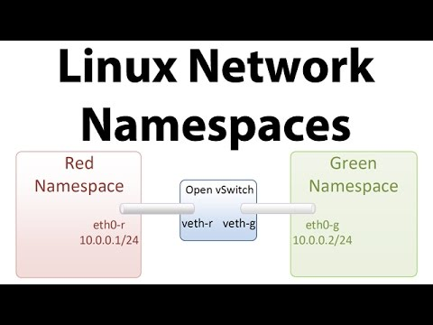
Network Namespace :
Network namespaces is a Linux kernel feature allowing us to isolate network environments through virtualization , it is a logical copy of the network stack from the host . We can assign Ip address ,network Interfaces,routing table to the virtual systems we create.

Slide 5
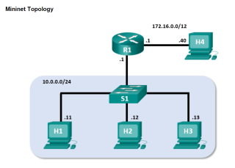
Mininet :
Mininet is a open source software emulator for creating large networks on a single machine. It allows us to create different topologies consisting of OpenFlow switches and hosts.We can easily create a realistic virtual network using mininet. Topologies can vary from a single switch to more complicated topologies c . We can easily interact with our network using mininet CLI , customize it , share it or deploy it .

Slide 6
Connect Network Namespaces to internet using Open Virtual Switch:
Create Network Namespaces : sudo ip netns add <namespace_name>
Create Layer-2 Virtual Network with OpenVSwitch : sudo ovs-vsctl add-br <bridge_name>
Create Network Interfaces Links and add those to bridge and namespaces :
sudo ip link add <interface1_name> type veth peer name <interface2_name>
sudo ip link set <interface_name> netns <namespace_name>
sudo ovs-vsctl add-port <bridge_name> <interface_name>
Enable the interfaces and Bridge :
sudo ip netns exec <namespace_name> ifconfig <interface_name> up
sudo ifconfig <bridgeInterface_name> up
sudo ifconfig <bridge_name> up

Slide 7
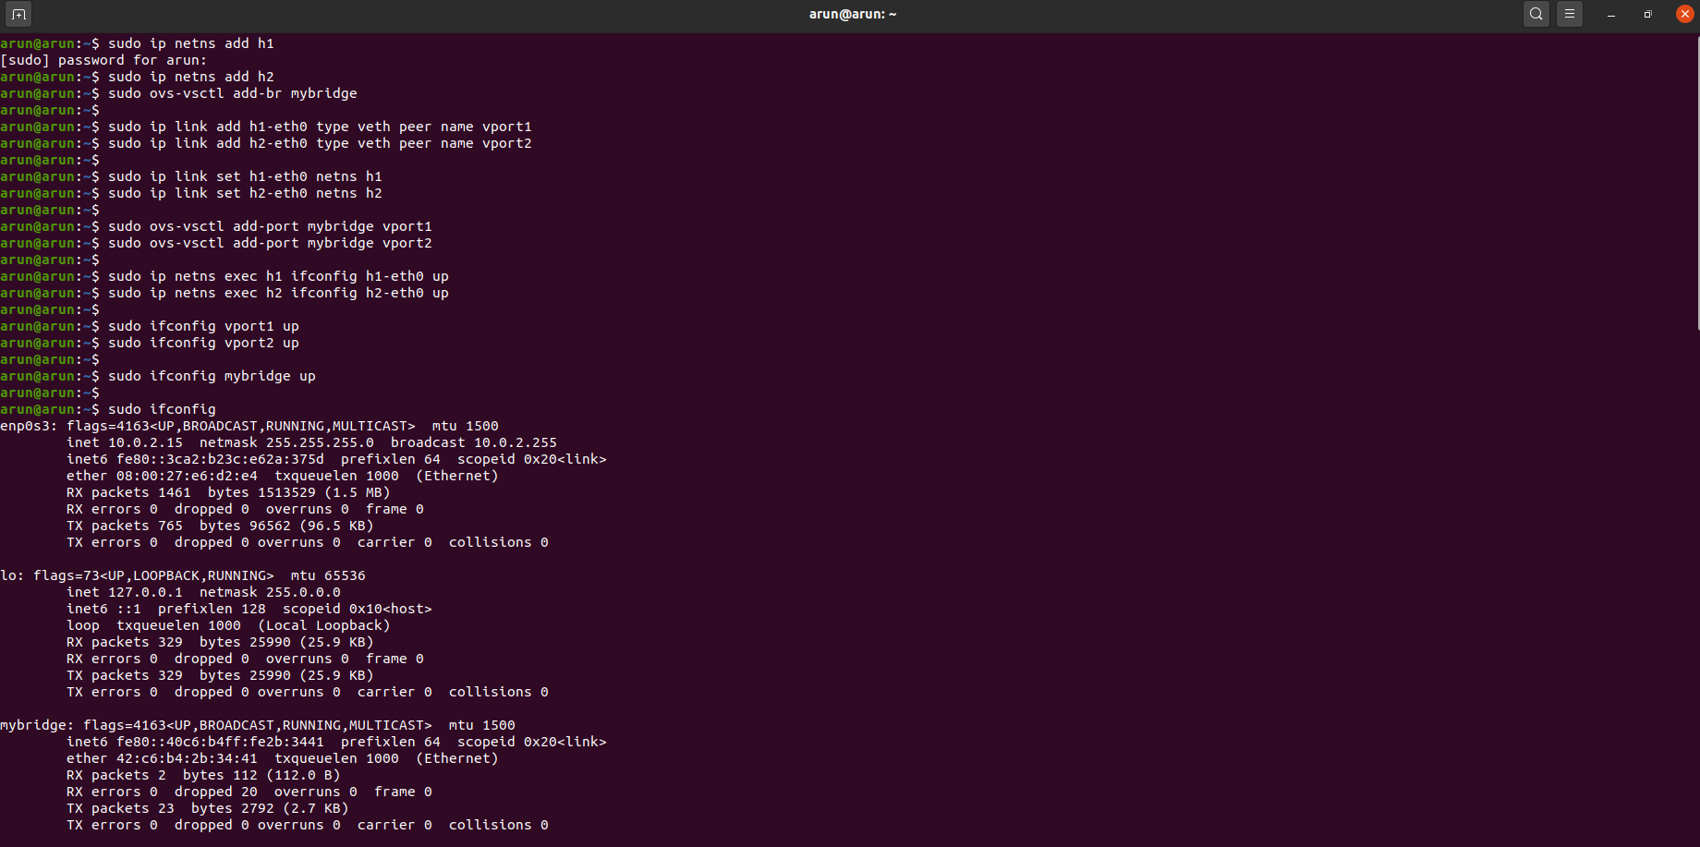

Slide 8
Add the Internet Network interface to the bridge :
Sudo ovs-vsctl add-port <bridge_name> enp0s3/eth0(Interface_Name)
Assign the IP address to bridge and Interfaces using dhclient :
(dhclient : requests IP Address from a DHCP Server)
Sudo dhclient <bridge_name>
Sudo ip netns exec <namespace_name> dhclient <interface_name>
See the Kernel IP Routing table : sudo route -n
Open bash in Network Namespace : sudo ip netns exec <namespace_name > bash
Run Applications in Network Namespace Bash :
Sudo runuser -u <user_name> – <application_name>

Slide 9
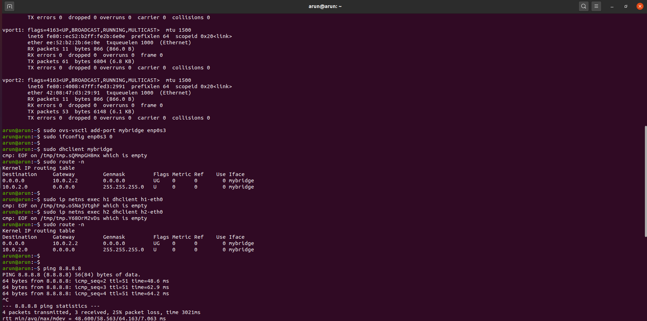
.

Slide 10
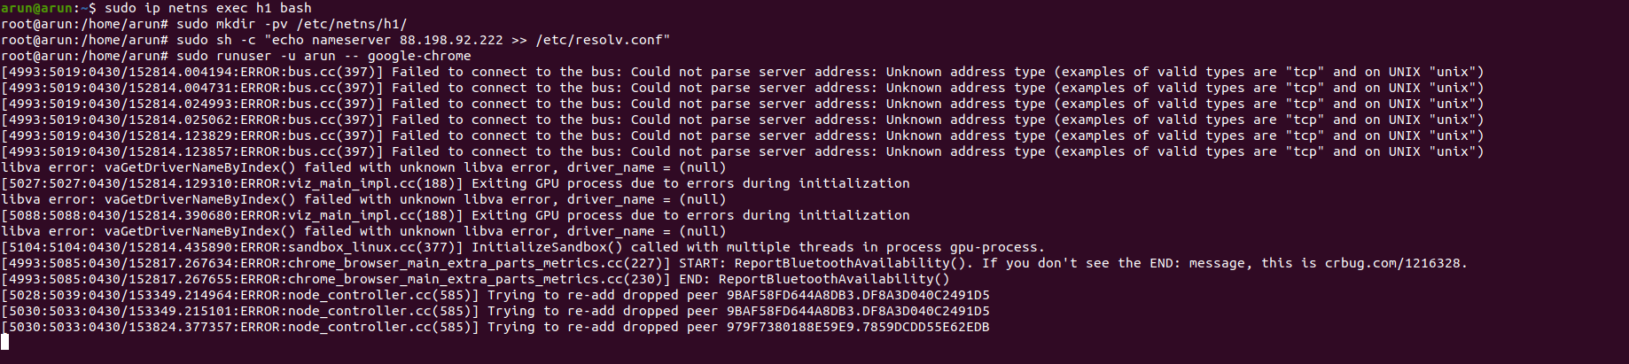

Slide 11
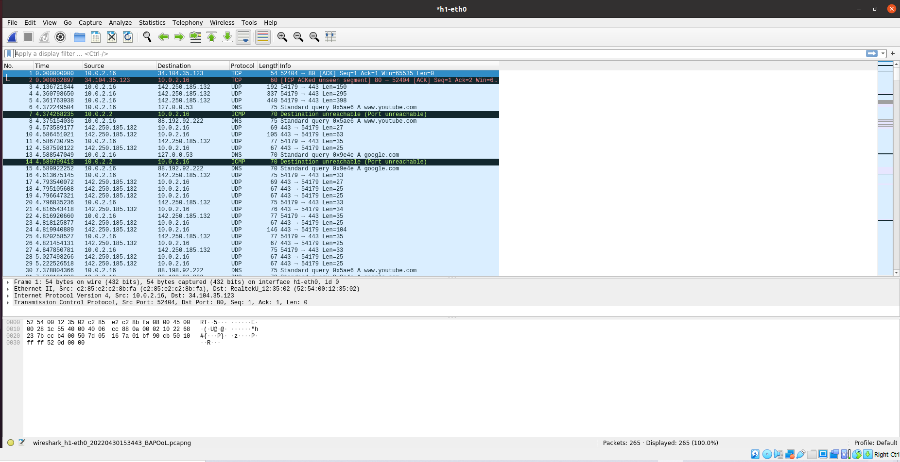
Tracing packets in wireshark in Network Namespace:

Slide 12
Connect Network Namespaces to internet using Mininet :
Create topology of consisting 1 switch and 2 hosts :
Sudo mn –topo=single,2
Enable/Up the switch : sudo ifconfig <switch_name> up
Assign IP Address to Switch : dhclient <switch_name>
Open the terminal for for host in mininet : xterm <host_name>
Assign IP Address to hosts : host_name> dhclient <interface_name>
Run Wireshark on Host : sudo wireshark
Run Applications in host : runuser -u <user_name> – <application_name>

Slide 13
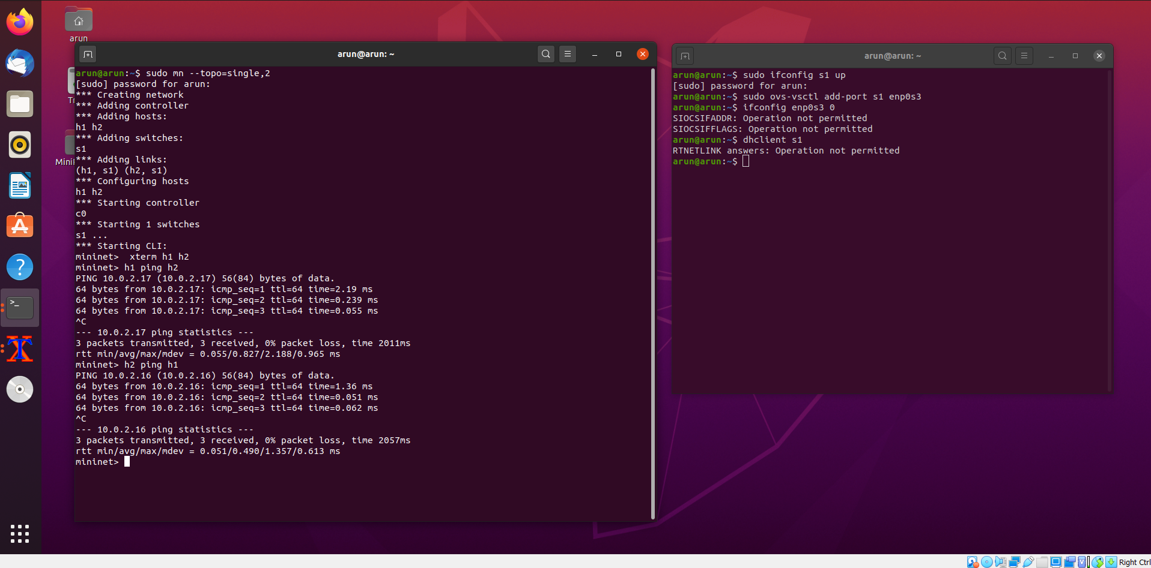

Slide 14
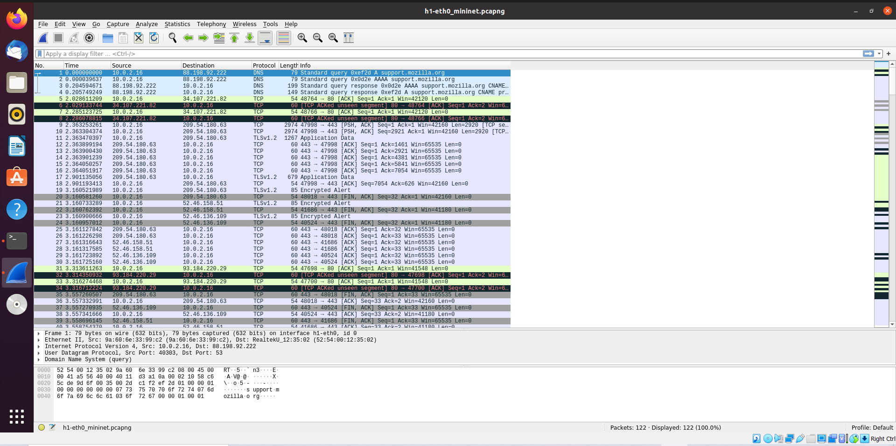
Tracing Packets in Wireshark on host in Mininet :

Slide 15
Create a network namespace and run a webserver on namespace :
Create A Network Namespace : sudo ip netns add <namespace_name>
Execute commands in Network Namespace :
sudo ip netns exec <namespace_name> your-command
Set the IP Address to the Default Interface “lo” in the Namespace :
sudo ip netns exec <namespace_name> ifconfig lo <IP_address> up
See the Network Interfaces on Network Namespace :
Sudo ip netns exec <namespace_name> ifconfig -a

Slide 16
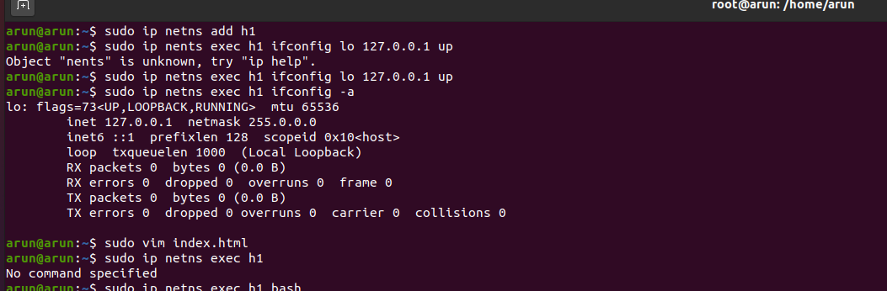
Implementation :

Slide 17
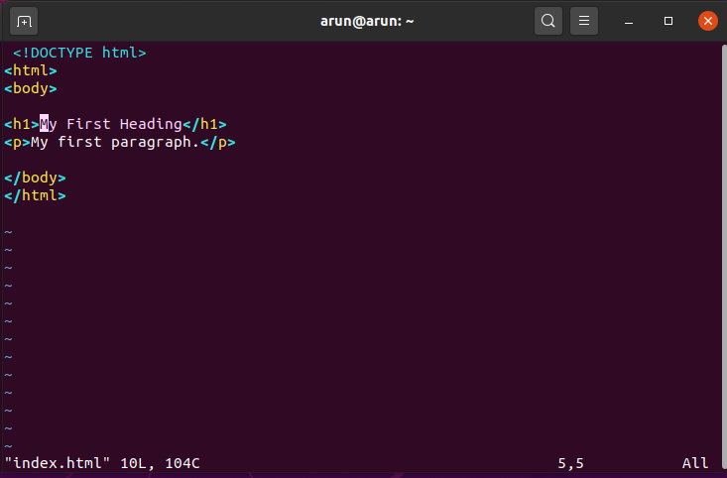
Create a web page (index.html) :

Slide 18
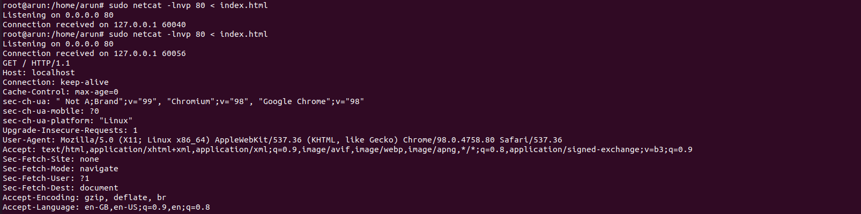
Run a webserver on port 80 , in namespace using natcat command :
Sudo netcat -lnvp 80 < index.html

Slide 19
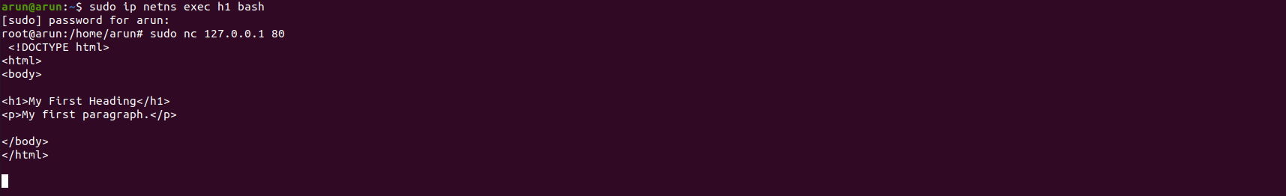
Access webserver from namespace :
Open namespace : sudo ip netns exec <namespace_name> bash
Access webserver in namespace : sudo netncat <IP_Address> <Port_No(80)>

Slide 20
Conclusion :
Network virtualization describes the combination of one or more platforms to form a virtual network.These virtual networks can act as an independent entity , enabling us to emulate links between services and applications. Network virtualization is possible through links and nodes. We can create our own virtual networks based on our requirements .

Slide 21
References :
http://sdnflex.org/?page_id=2
https://ivypanda.com/essays/concept-of-the-network-virtualization/#:~:text=.%2C%202013).-,Conclusion,links%20between%20services%20and%20applications.
https://www.cloud-native-everything.com/network-namespaces-in-5-min/
https://fosshelp.blogspot.com/2014/07/how-to-create-network-namespace-and-run.html
https://gist.github.com/shreyakupadhyay/84dc75607ec1078aca3129c8958f3683

